Slide 1
2014 Global Competition of Energy Forecasting
Mohamed Abuella
Fall 2014
UNCC

Slide 2
Forecasting Model Stages
Model Results
2014 Energy Forecasting Global Competition
Presentation Outline

Slide 3

CrowdANALYTIX
Cloud-Based Completions
website
https://www.crowdanalytix.com

Slide 4
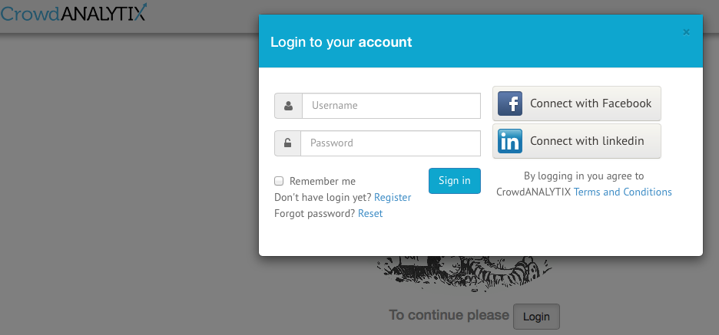
https://www.crowdanalytix.com

Slide 5

Bunch of
Various
Completions
The website
Provides

Slide 6
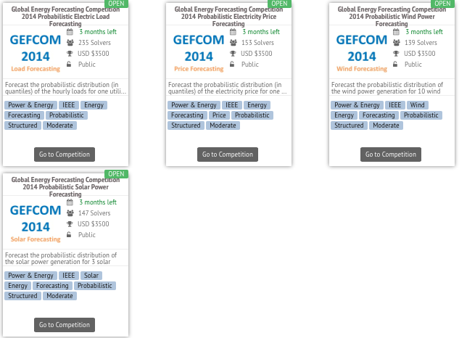
The Global Energy Forecasting Competition 2014 (GEFCom2014) will bring together state-of-the-art techniques and methodologies for probabilistic energy forecasting. GEFCom2014 features four tracks: Probabilistic Electric Load Price Forecasting, Wind, and Solar Power Forecasting.
Global Energy Forecasting Tracks:
Load
Solar
Wind
Price

Slide 7
Solar Power Forecasting Track
Objective
The topic of the probabilistic solar power forecasting track is to forecast the probabilistic distribution (in quantiles) of the solar power generation for 3 solar farms on a rolling basis. The three solar farms are adjacent. Their installation parameters are:
Zone1: Altitude (595m) Panel type (Solarfun SF160-24-1M195) Panel number (8) Nominal power (1560W) Panel Orientation (38° Clockwise from North) Panel Tilt (36°).
Zone2: Altitude(602m) Panel type (Suntech STP190S-24/Ad+) Panel number (26) Nominal power (4940W) Panel Orientation (327° Clockwise from North) Panel Tilt (35°).
Zone3: Altitude(951m) Panel type (Suntech STP200-18/ud) Panel number (20) Nominal power (4000W) Panel Orientation (31° Clockwise from North) Panel Tilt (21°)

Slide 8
Solar Power Forecasting Track
Data Description
The target variable is solar power. There are 12 independent variables from the ECMWF NWP output to be used as below.
078.128 Total column liquid water (tclw) - unit (kg m**-2) - Vertical integral of cloud liquid water content.
079.128 Total column ice water (tciw) - unit (kg m**-2) - Vertical integral of cloud ice water content.
134.128 surface pressure (SP) - Unit: Pa.
157.128 Relative humidity at 1000 mbar (r) -unit (%)
164.128 total cloud cover (TCC) - Unit: (0-1)
165.128 10 metre U wind component (10u) - unit (m s**-1)
166.128 10 metre V wind component (10V) - unit (m s**-1)
167.128 2 metre temperature (2T) - Unit: K
169.128 surface solar rad down (SSRD) - Unit: J m-2 - Accumulated field
175.128 surface thermal rad down (STRD) - Unit: J m-2 - Accumulated field.
178.128 top net solar rad (TSR) – Unit: J m-2 - Net solar radiation at the top of the atmosphere. Accumulated field.
228.128 total precipitation (TP) - Unit: m.

Slide 9
Solar Power Forecasting Track
Data Description
The target variable is solar power. There are 12 independent variables from the ECMWF NWP output to be used as below.
078.128 Total column liquid water (tclw) - unit (kg m**-2) - Vertical integral of cloud liquid water content.
079.128 Total column ice water (tciw) - unit (kg m**-2) - Vertical integral of cloud ice water content.
134.128 Surface pressure (SP) - Unit: Pa.
157.128 Relative humidity at 1000 mbar (r) -unit (%)
164.128 Total cloud cover (TCC) - Unit: (0-1)
165.128 10 metre U wind component (10u) - unit (m s**-1)
166.128 10 metre V wind component (10V) - unit (m s**-1)
167.128 2 metre temperature (2T) - Unit: K
169.128 Surface solar rad down (SSRD) - Unit: J m-² - Accumulated field
175.128 Surface thermal rad down (STRD) - Unit: J m⁻² - Accumulated field.
178.128 Top net solar rad (TSR) – Unit: J m⁻² - Net solar radiation at the top of the atmosphere. Accumulated field.
228.128 Total precipitation (TP) - Unit: m.

Slide 10
Solar Power Forecasting Track
Solvers Expectations:
During the competition period, the contestants are required to submit probabilistic forecasts in the form of quantiles following the exact format provided in the template file.
Evaluation Metric Pin ball function will be used to evaluate the accuracy of probabilistic forecasts. The winning teams will be determined by the prize committee based on the forecasting accuracy and final reports. The winning institute will be determined based on the performance of the participating teams.
Contest Timeline
Important Dates:
15 Aug. 2014 Historical data release (competition starts) 14 Sept. 2014 Evaluation period starts 10 Oct. 2014 Registration deadline 6 Dec. 2014 Evaluation period ends 15 Dec. 2014 Final report and code due (competition ends)
Prizes
Team prize:
1st place - $2500
2nd place - $500
3rd place - $500

Slide 11
Solar Power Forecasting Track
Data Guidelines:
There are three data files available for each week of the competition period.
The predictor file ("predictorsXX.csv") contains all the independent variables during both the training period and the test period.
The training file ("trainXX.csv") contains the targe variable during only the training period. And the template file ("templateXX.csv") provides a template of the final output. The TIMESTAMP is in UTC time zone.
The benchmark in the solar forecasting track was created by taking the same month last year as the predicted solar power across all quantiles. This is a naïve benchmark, which takes a naïve forecast and expands it to 99 quantiles. The contestants do NOT have to provide the same value across all quantiles.

Slide 12
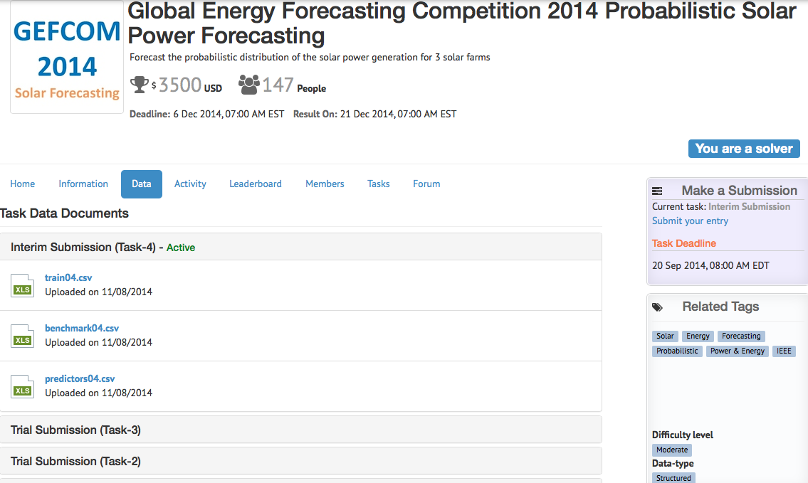
Solar Power Forecasting Track

Slide 13
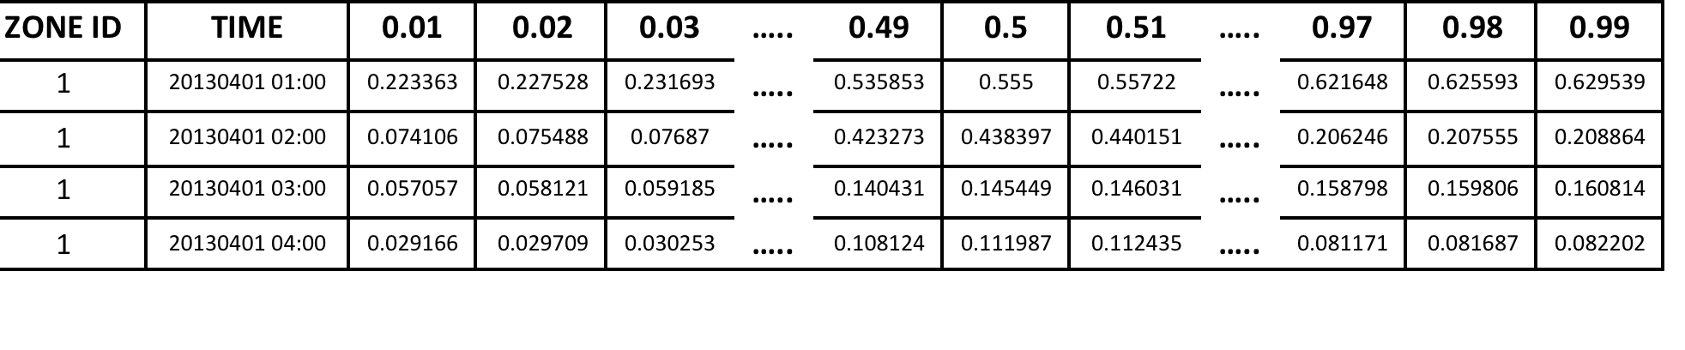
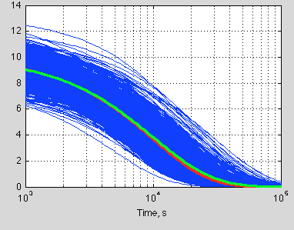
Solar Power Forecasting Track
The Probabilistic Forecasts

Slide 14
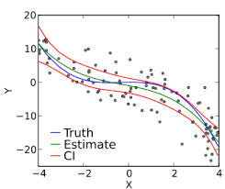
Solar Power Forecasting Track
The Pinball Loss Function for Probabilistic Forecasts
For a quantile forecast q_{a} with a/100 as the target quantile, this score L is defined as:
Where is the observation used for verification, and
To evaluate the full predictive densities, this score is then averaged over all target quantiles, from 0.01 to 0.99, for all time periods over all forecast
horizons. The lower the score, the better the forecasts are.

Slide 15
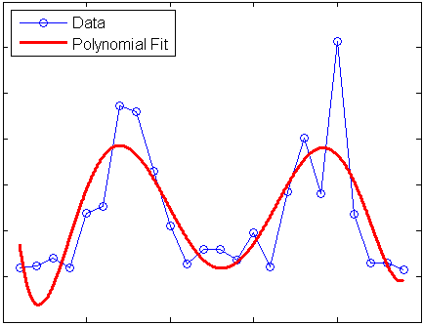
Solar Power Forecasting Track
Forecasting in abstract meaning is
Regression;
Extrapolation.
Model:
For example, linear models:

Slide 16
Model Steps
Data Preparation: Some treatments to data to become adaptive to the model and software.
Training: Select historical data to identify the regression for the solar power.
Validation: Select a sample of data to be forecasted and checking he performance of the model by comparison with the already observed data.
Testing: At this step, the model will be used for forecasting future solar power.

Slide 17
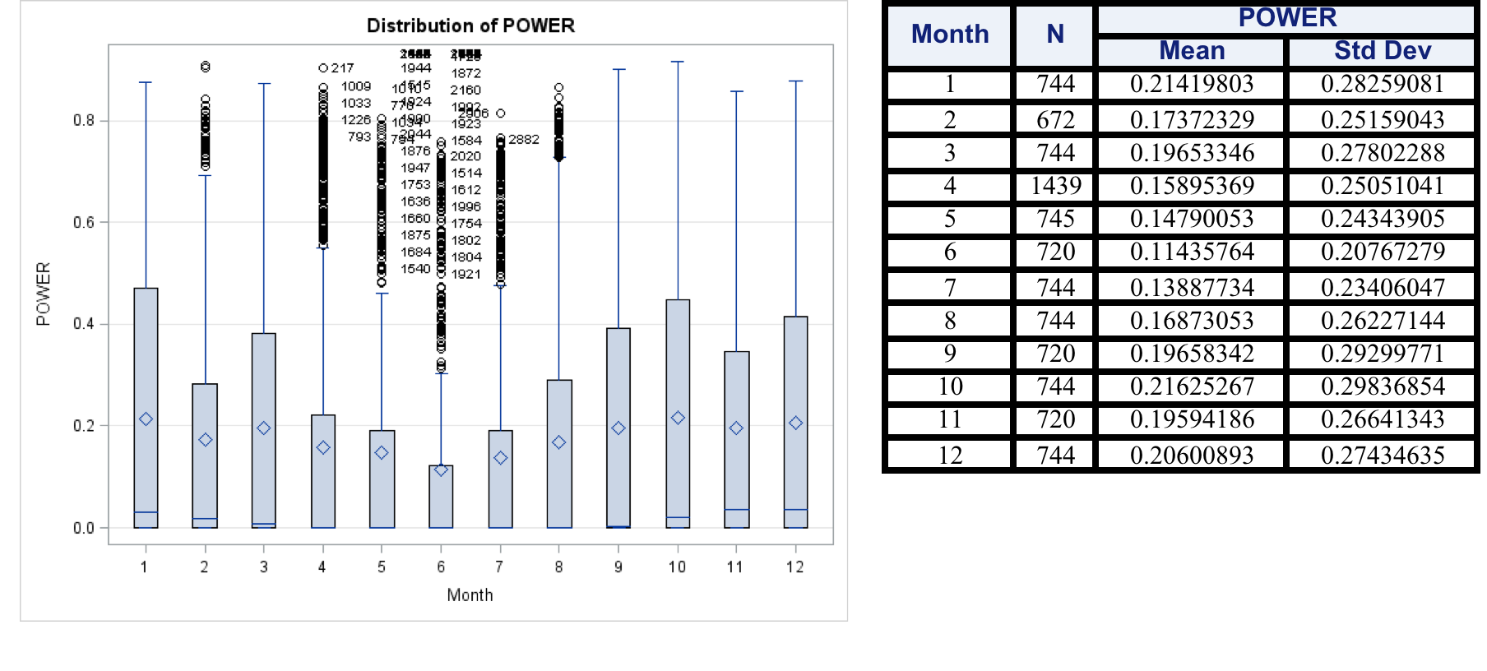
Data Preparation
Historical Data:
The box plot of the distribution of the means of the solar power for the moths of 2012.
This leads to 4,5,6,7 are cloudy or less sunny months.
Are they April, May, June and July ? They could maybe just rearranged in this order.
Since the weather data from: ECMWF© European Centre for Medium-Range Weather Forecasts

Slide 18
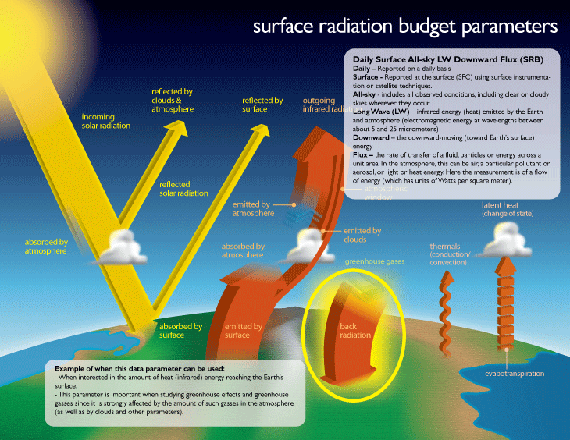

Slide 19
Data Preparation
From Data Description:
169.128 Surface solar rad down (SSRD)
Unit: J m-² Accumulated field
Surface Solar Irradiance Down (SSRD)

Slide 20
Variables Selection
Surface Solar Irradiance Down (SSRD)
Total Cloud Cover
Precipitation
Surface Thermal Irradiance

Slide 21
Variables Selection
Surface Solar Irradiance Down (SSRD)
Total Cloud Cover
Precipitation
Surface Thermal Irradiance

Slide 22
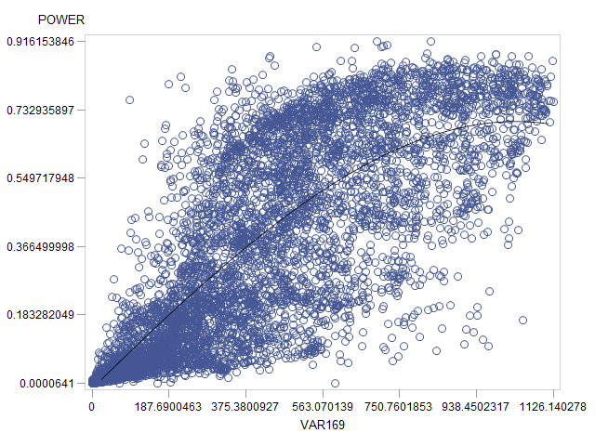
Variables Selection
Data Preparation
Solar Power vs. Surface Solar Irradiance Down (SSRD)
169.128 (SSRD) : J/m² Accumulated field (for all day hours)
169.128 (SSRD) w/m² Average Value (for each hour)

Slide 23
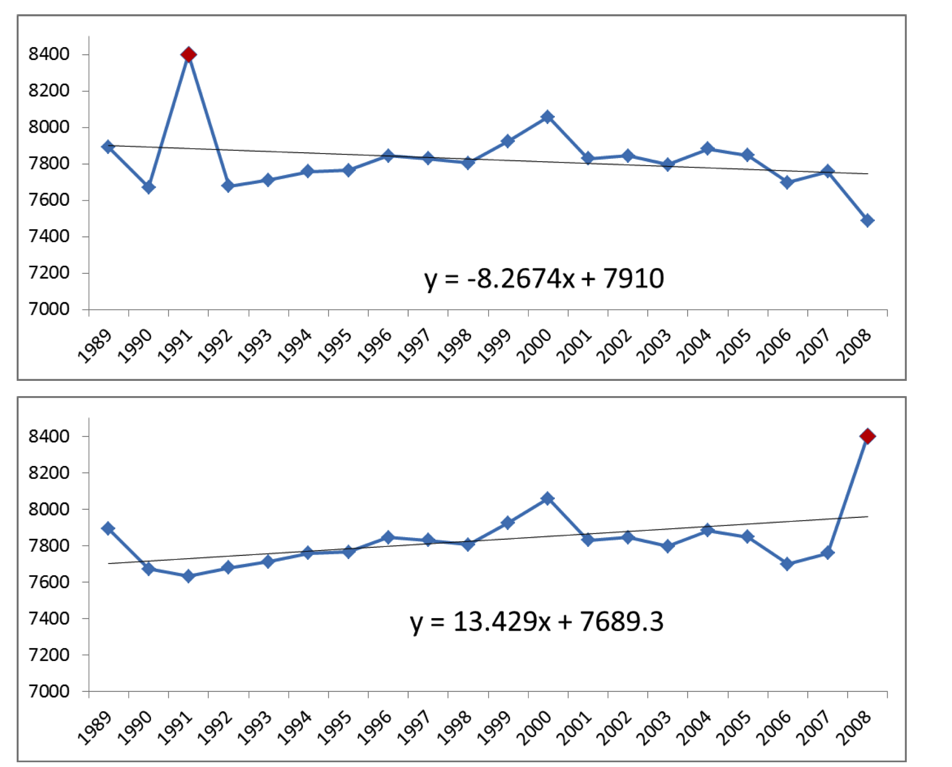
Variables Selection
Data Preparation
Check out the data trend and the affects of outliers:
Surface Solar Irradiance Down (SSRD)

Slide 24
Variables Selection
Samples of Real Data:
Month October, 2012 at 01:00
700W/m² > SSRD> 600W/m²

Slide 25
Variables Selection
Samples of Real Data:
Month October, 2012 at 01:00
SSRD > 900W/m²

Slide 26
Variables Selection
December 31st, 2013 at 01:00
Top Net Solar Irradiance = 9084W/m²

Slide 27
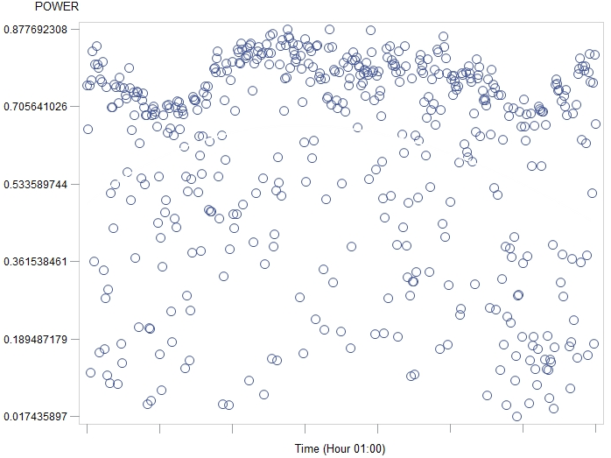
Variables Selection
Data Preparation
Check out the data trend and the affects of outliers:
Avg. Solar Irradiance vs. Time (hour=01:00)
Solar Power vs. Time
Avg. Solar Irradiance vs. Time (hour=01:00)
Surface Solar Irradiance Down (SSRD) vs.Time

Slide 28
Variables Selection
Data Preparation
Check out the data trend and the affects of outliers:
Solar Power vs. Surface Solar Irradiance Down (SSRD)

Slide 29
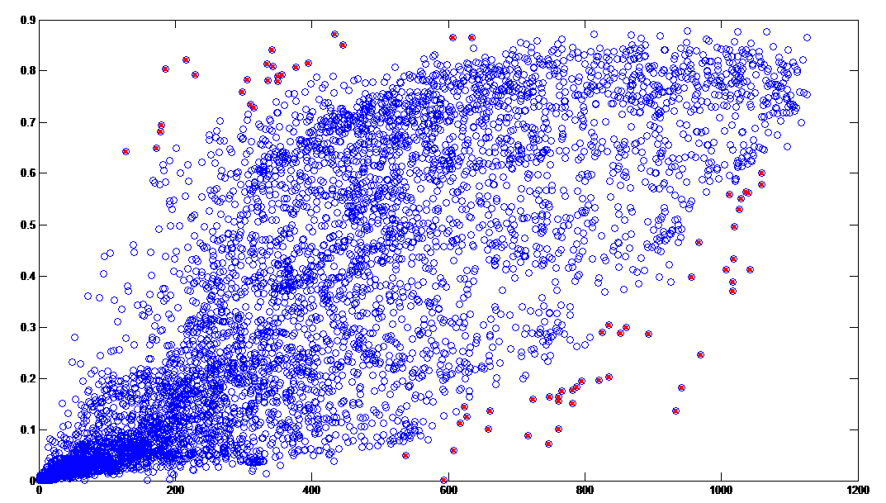
Variables Selection
Data Outliers:

Slide 30
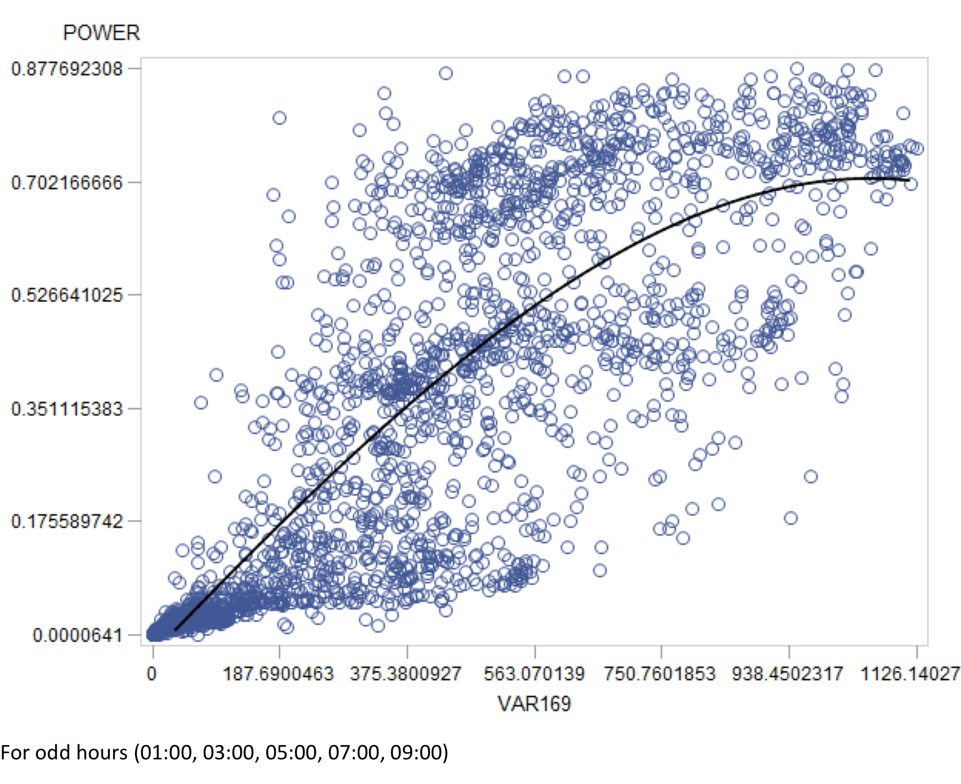
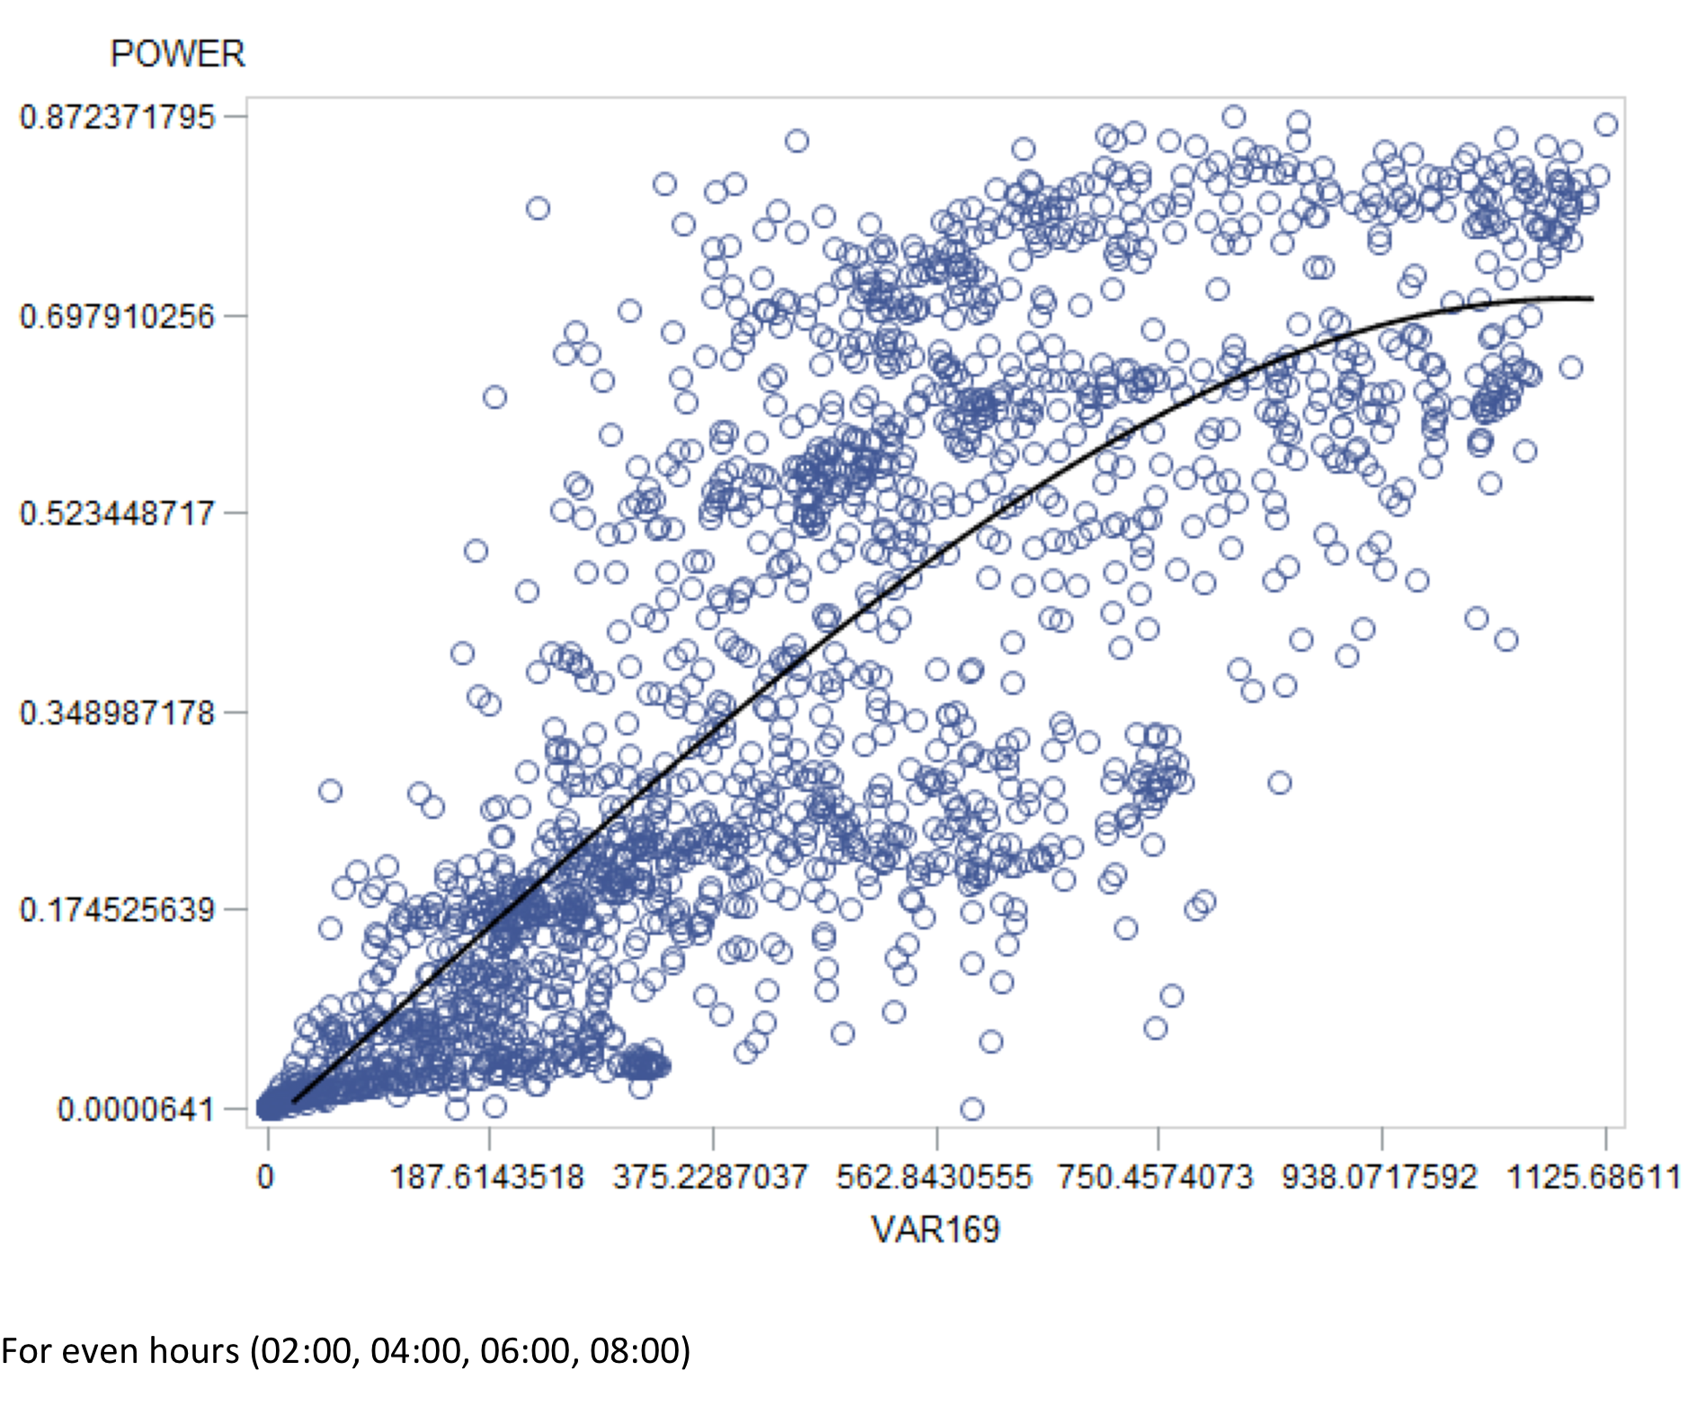
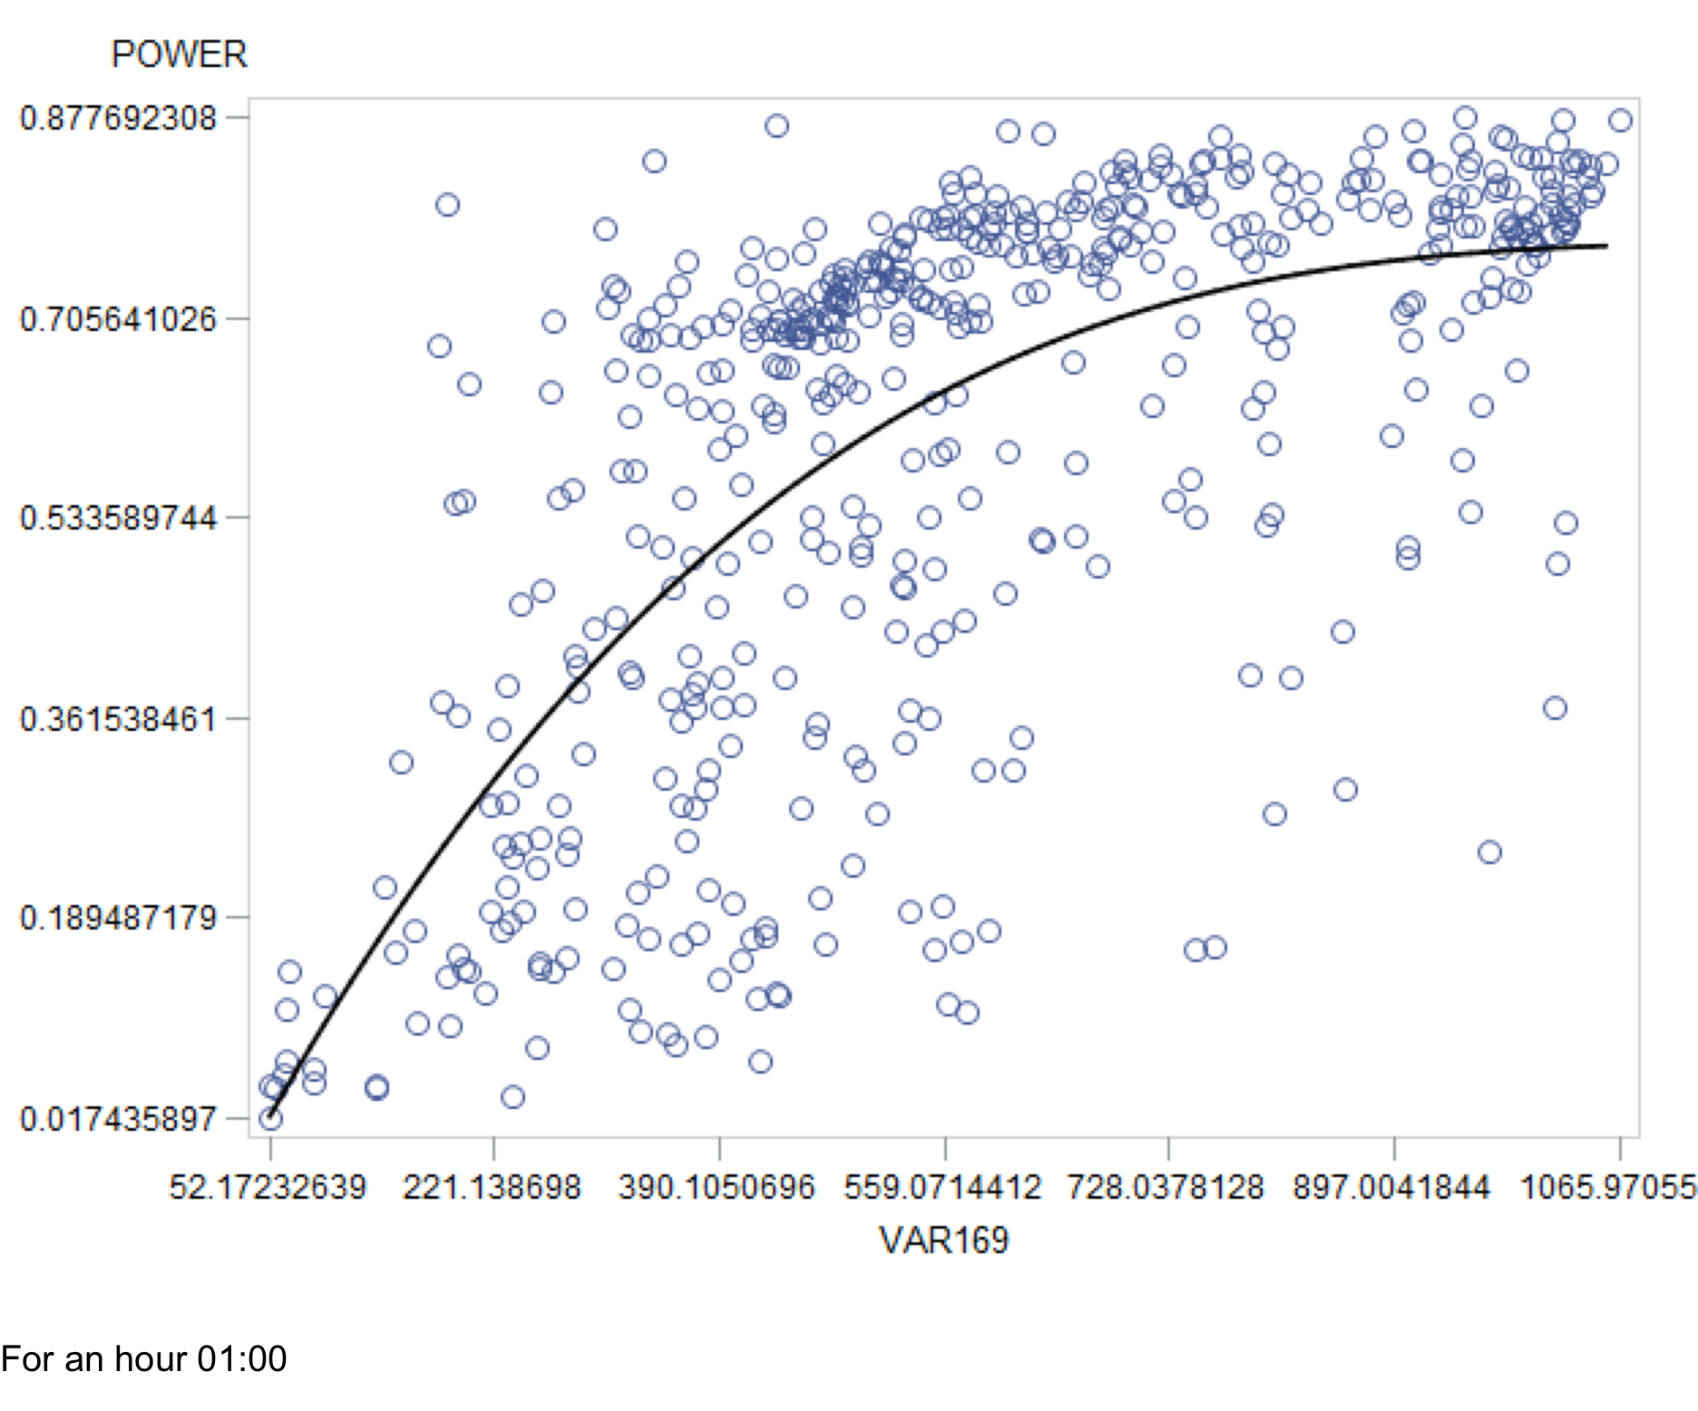
Variables Selection
Data Preparation
Check out the data trend and the affects of outliers:
(SSRD)

Slide 31
Variables Selection
Data Preparation
The solar power vs. solar irradiance for three zones
Zone1
P_{max}=0.91
Zone2
P_{max}=0.97
Zone3
P_{max}=0.99

Slide 32
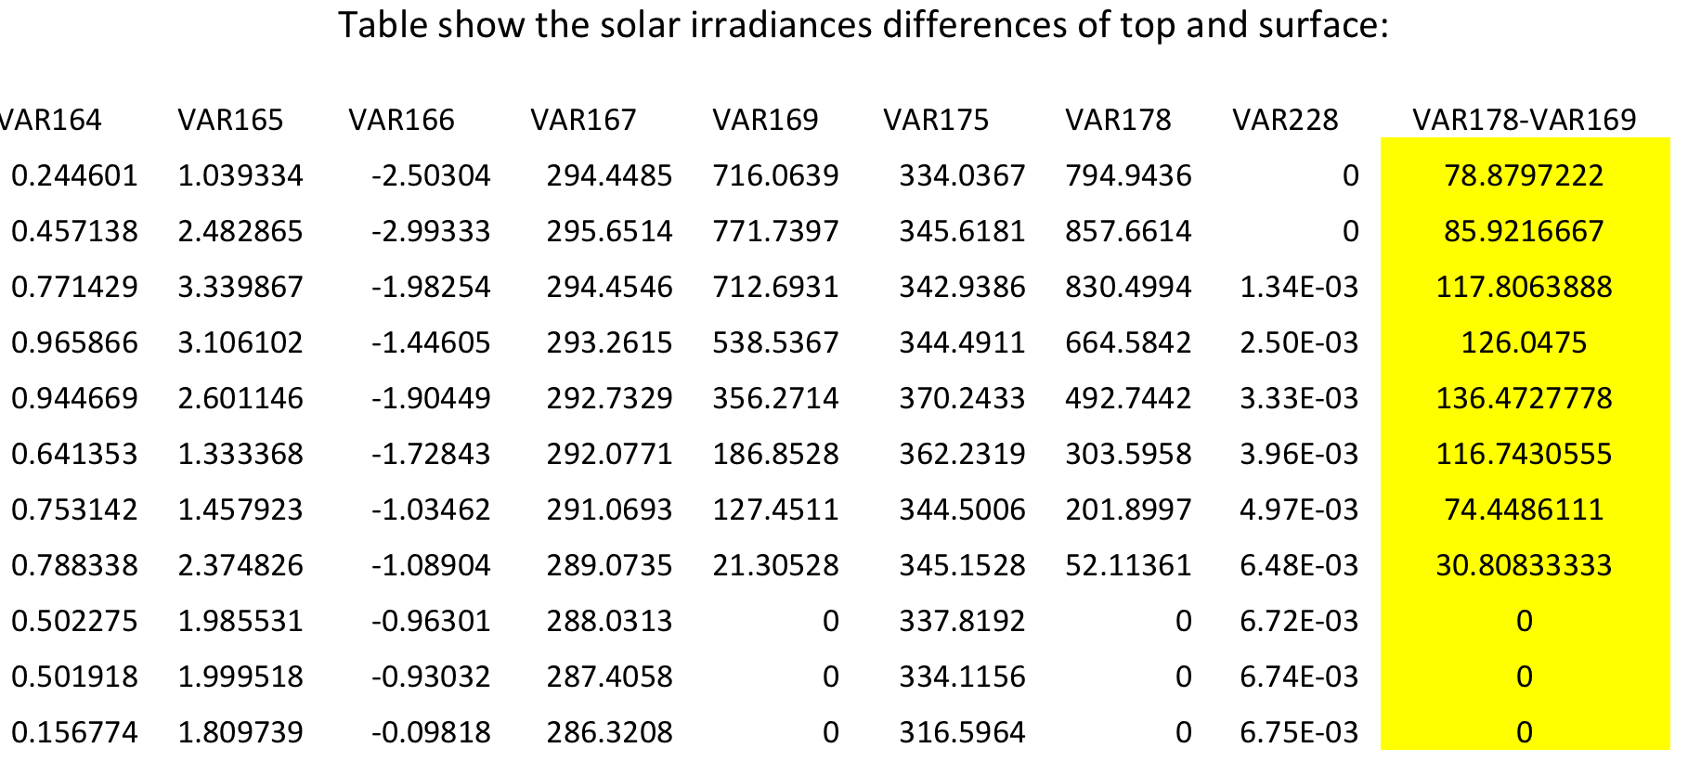
Variables Selection
178.128 or 169.128 (SSRD)?
178.128 Top net solar rad. (TSR) – Unit: J m⁻² - Net solar radiation at the top of the atmosphere. Accumulated field.

Slide 33

Variables Selection
167.128 or 175.128?
167.128 2-metre temperature (2T) - Unit: K
175.128 Surface thermal rad down (STRD) - Unit: J m⁻² - Accumulated
When the solar panel temperature increases, the growth rate of solar power vs. solar irradiance decreases.
However, the solar power still grows with solar irradiance whatever the temperature is.

Slide 34
Variables Selection
167.128 or 175.128?
167.128 2-metre Temperature (2T) - Unit: K
175.128 Surface thermal radiation down (STRD) - Unit: J m⁻² – Accumulated.
167.128 2-metre Temperature (2T) - Unit: K
Solar Power increase with increasing of either 167.128 or 175.128 !
That because neither 167.128 nor 175.128 are the solar temperature, they represent
the ambient temperature.

Slide 35
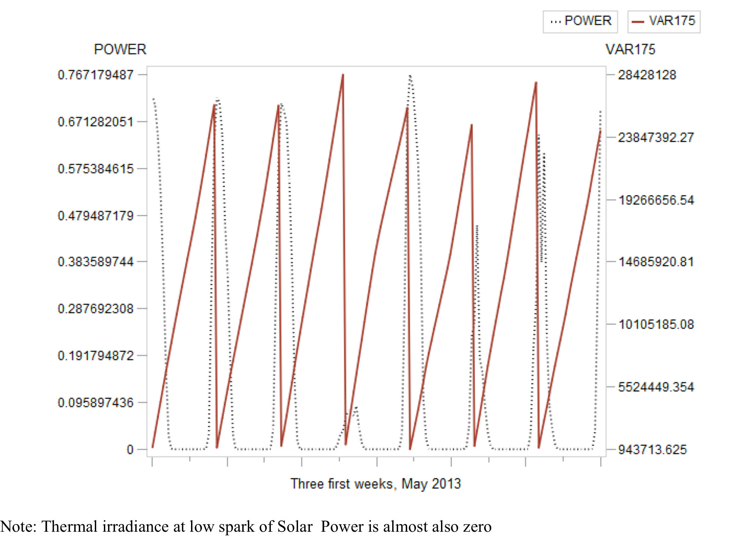
Variables Selection
175.128 Surface thermal rad. down (STRD) is also useful

Slide 36
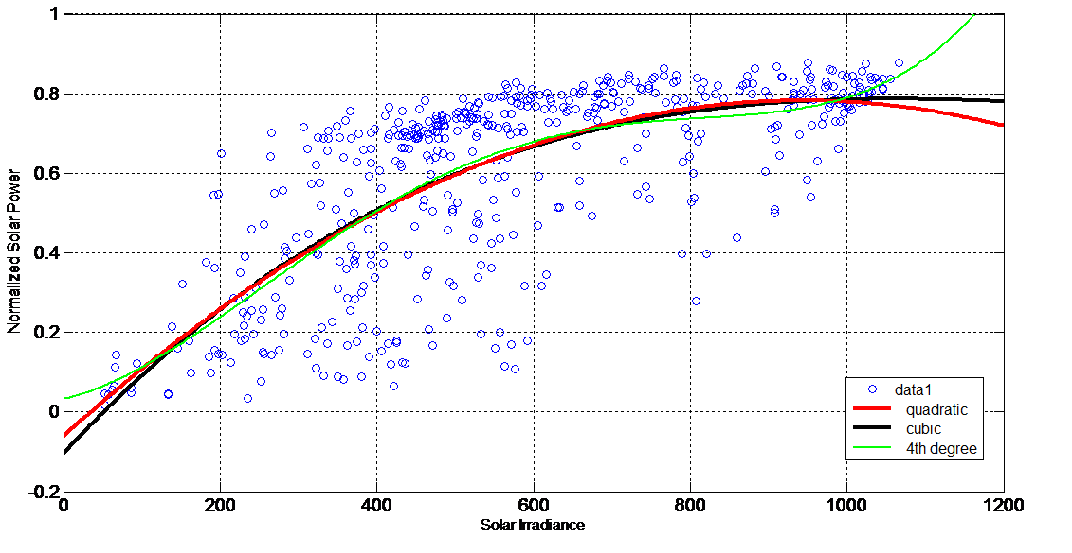
Variables Selection
SSRD with Ln, 2nd or 3rd Polynomials:
Quadratic:
y = p1*x^2 + p2*x + p3
Coefficients:
p1 = -9.4913e-07
p2 = 0.0017901
p3 = -0.061731
Norm of residuals =
3.6151
Cubic:
y = p1*x^3 + p2*x^2 +p3*x + p4
Coefficients:
p1 = 3.848e-10
p2 = -1.6087e-06
p3 = 0.0021135
p4 = -0.10454
Norm of residuals =
3.6122
4th degree Polynomial:
y = p1*x^4 + p2*x^3 + p3*x^2 + p4*x + p5
Coefficients:
p1 = 3.5244e-12
p2 = -7.5065e-09
p3 = 4.3011e-06
p4 = 0.00043816
p5 = 0.033125
Norm of residuals =
3.5957

Slide 37
Variables Selection
Not brushing out the outliers but rather
assign them to the fitting polynomials curve:
Quadratic:
y = p1*x^2 + p2*x + p3
Coefficients:
p1 = -9.4913e-07
p2 = 0.0017901
p3 = -0.061731
Norm of residuals =
3.6151

Slide 38
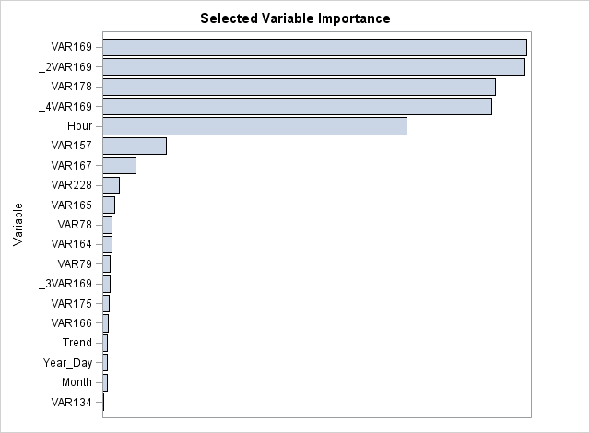
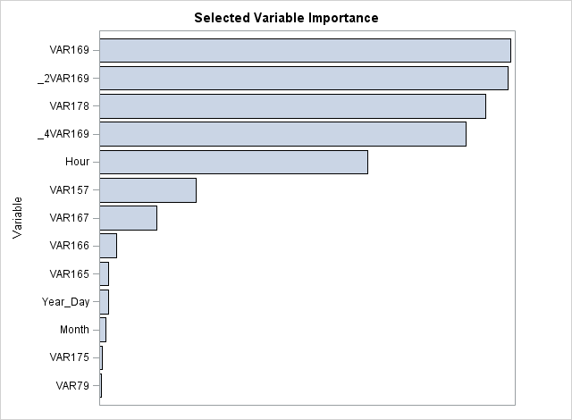
Variables Selection
Variables importance:
Sensitivity Analysis by using Data Mining
2nd Poly. VAR169
3rd Poly. VAR169
2nd Poly. VAR175
Variables importance: (For model with night hors i.e. zero solar power)
Variables importance: (For model not including night hors i.e. zero solar power)

Slide 39
Variables Selection
157.128 Relative humidity at 1000 mbar (r) -unit (%)

Slide 40
Variables Selection
Classifications Variables:
Hours Months are considered as classification variables.
Because the hours of the day and months the solar irradiance mean is changing. So the solar power as well.
Why week days are not considered as class. variables ?
Because the solar irradiance in Sundays could be similar as Mondays or Fridays.
To increase the resolution the year days also could be chosen as class. variables.
But they should be periodical 365 days and so on (or 366 in 2012 “leap year”).

Slide 41
Variables Selection
Interaction Variables:
The interaction between the variables is inevitable.
As in obvious case of the interaction between the solar irradiance and the output power with the solar panel temperature.
Because the solar irradiance affects the solar power and the solar power affected by temperature of the solar panels as well. Besides, the panel temperature is also affected by solar irradiance.
So the temperature is an interaction variables (169*167*time) time could be hours, days, or months
There are other interaction between the variables, such as Precipitation and Solar irradiance.

Slide 42
Validation
By visualization:

Slide 43
Validation
By visualization:

Slide 44
Validation
By visualization:

Slide 45
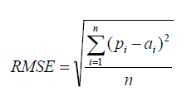
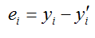
Validation
By using forecast accuracy metrics:
Root mean square error (RMSE);
Residuals summation;
Residuals mean;
Pinball loss function. (For probabilistic forecasts)
Note: When forecasts of Task7-model replace the Pr50 with actual October 2013 data (got from Training08-data Task8)
PB changed from 0.01528 to 0.01509. So the majority of residuals are from the Confidence Interval errors.

Slide 46
Test
April 2013
The naïve-forecasts have been used.

Slide 47
Test
May 2013
Using SAS Enterprise-Guide to build the model.

Slide 48
Test
June 2013
Selection of variables is done by graphs and MATLAB has been used to adjust the outcomes.

Slide 49
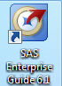
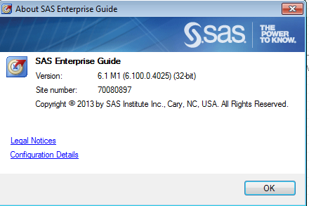
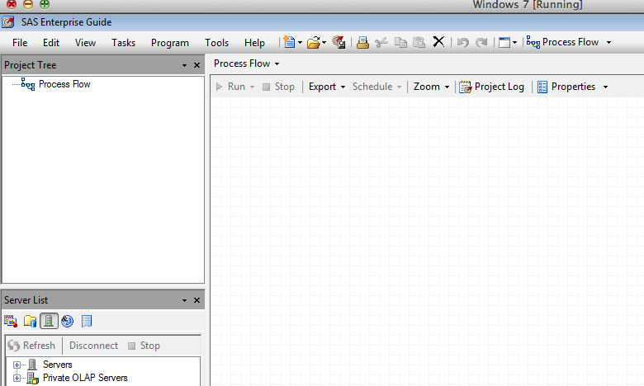
SAS model

Slide 50
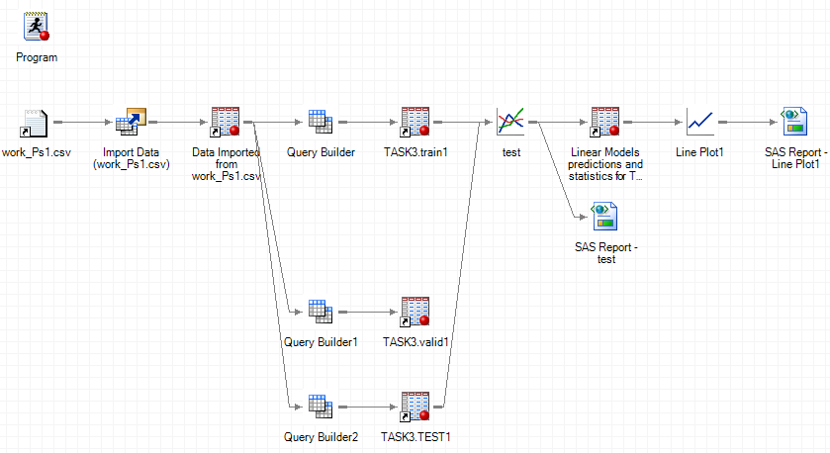
SAS model

Slide 51
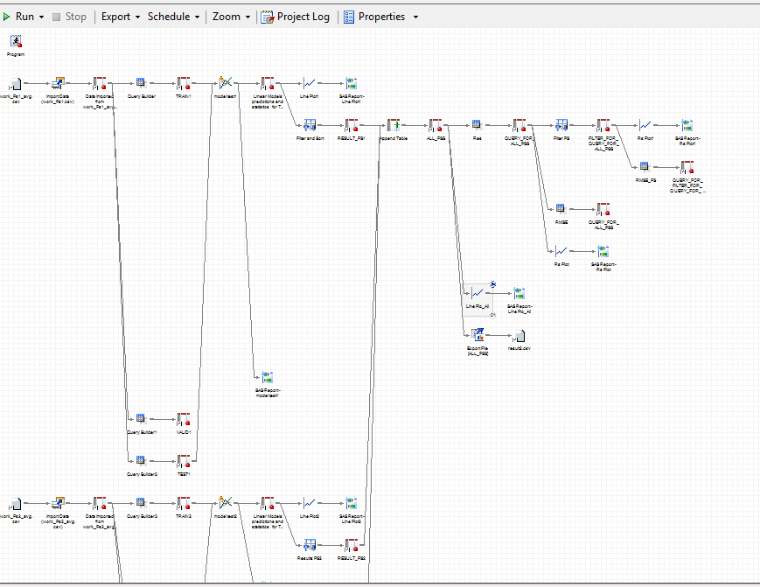
SAS model

Slide 52
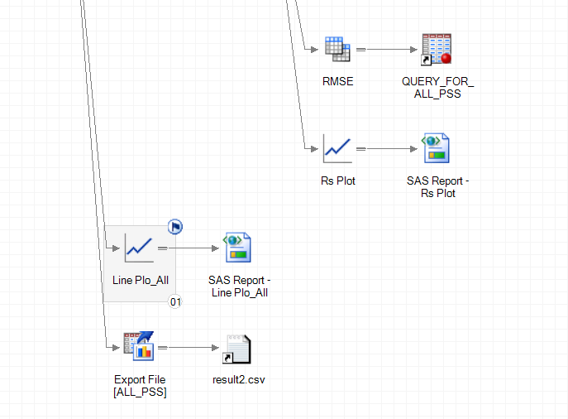
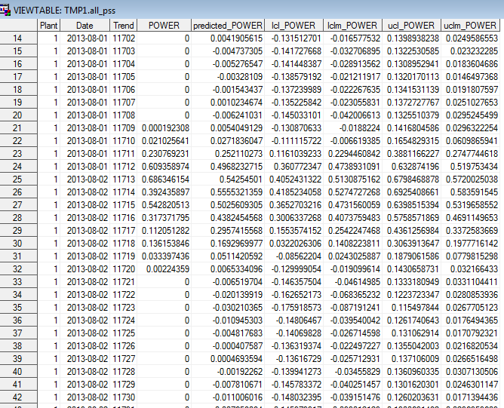
SAS model

Slide 53
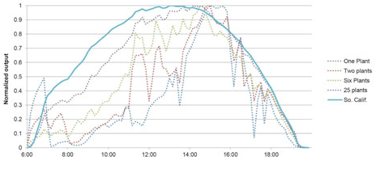
Results
Zone1: (8) Nominal power (1560W) Panel Orientation (38° Clockwise from North) Panel Tilt (36°).
Zone2: (26) Nominal power (4940W) Panel Orientation (327° Clockwise from North) Panel Tilt (35°).
Zone3: Panel number (20) Nominal power (4000W) Panel Orientation (31° Clockwise from North) Panel Tilt (21°)
Model validation and comparison:
August 2013
Zone
Zone
Zone
PS3 with more panels, now is better than PS2.

Slide 54
Results
Some Observations:
September 2013:
Zone
Zone
Using Polynomial of 2nd and 3rd
degrees for Solar irradiance
VAR.169.128
Zone
Zone
Using Ln of Solar irradiance
VAR.169.128
Zone
Zone
Using Square and Cubic roots
of Solar irradiance
VAR.169.128

Slide 55
Results

Slide 56
Results

Slide 57
Results
Box Plots for September:
Actual September 2013
Predicted September 2013

Slide 58
Results
Comparison September:
Actual September 2013
Predicted September 2013
Actual September 2013

Slide 59
Results
November 2013 Actual Data:
PW_act = -0.004933 + 0.001026*VAR169 - 2.575E-7*VAR169^2.

Slide 60
Results
November 2013 Actual Data and Forecasts:
PW_act = -0.004933 + 0.001026*VAR169 - 2.575E-7*VAR169^2.
PW_0.50 = -0.003373 + 0.001064*VAR169 - 3.206E-7*VAR169^2.

Slide 61
Results
November 2013 Actual Data and 99 quintile forecasts:
PW_act = -0.004933 + 0.001026*VAR169 - 2.575E-7*VAR169^2.
PW_0.99 = 0.020194 + 0.00155*VAR169 - 7.455E-7*VAR169^2.

Slide 62
Results
November 2013 Actual Data and 01quintile forecasts:
PW_act = -0.004933 + 0.001026*VAR169 - 2.575E-7*VAR169^2.
PW_0.01 = -0.007996 + 0.000591*VAR169 + 4.004E-8*VAR169^2.

Slide 63
q=0.99
q=0.50
q=0.01

Slide 64
SAS models codes
Zone

Slide 65
SAS models codes
Zone

Slide 66
Conclusion
Solar Forecasts Track in the Competition
In addition to the results, the general conclusions are ass following:
It’s a good exercise to know the flaws and overcoming them.
The tracks are helping increasing the focus and improving the performance.
In solar it’s not a short-term forecasting which is common for electricity markets and practical applications.
It is in-sample forecasting, since the explanatory variables (weather) are given from the existing actual historical data, while in out-sample forecasting these explanatory variables are forecasted data as well.
There is not enough information to adopt the physical approach in forecasting.
Since the forecasts are probabilistic, the pinball loss function is used in validation the models, while the model training doesn’t not use the pinball.

Slide 67
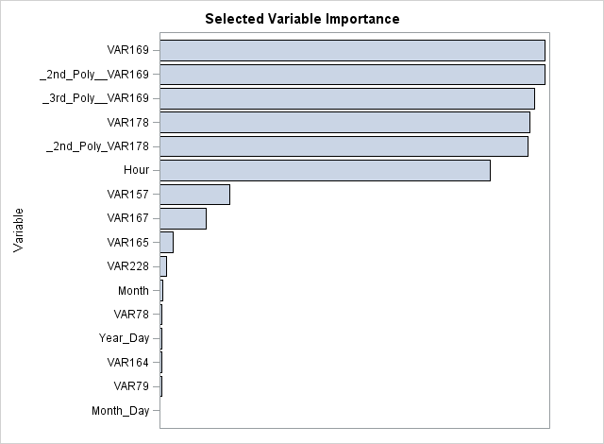

Slide 68
MODEL POWER=
VAR167 VAR169 VAR175 VAR228 "2VAR169"n Month Hour VAR79 VAR157 "3VAR169"n VAR169*Hour VAR169*Month "Month Day"n*VAR169 "2VAR169"n*Month "2VAR169"n*Hour VAR167*VAR169*Hour VAR169*VAR175*Hour VAR169*VAR157*Hour VAR169*VAR228*Hour VAR169*VAR79*Hour "Month Day"n "2VAR169"n*"Month Day"n Trend "4VAR169"n "5VAR169"n "Year Day"n "4VAR169"n*Month "4VAR169"n*Hour "4VAR169"n*"Month Day"n VAR78 VAR134 VAR164 VAR165 VAR166 VAR178 VAR178*Hour VAR178*Month "Month Day"n*VAR178 VAR79*Hour VAR228*Hour VAR157*Hour VAR175*Hour VAR167*Hour VAR134*Hour VAR78*Hour VAR164*Hour VAR165*Hour VAR166*Hour "3VAR169"n*Hour "3VAR169"n*Month "3VAR169"n*"Month Day"n "5VAR169"n*Hour "5VAR169"n*Month

Slide 69
Actual Power
Predicted Power
Residuals

